Slide 1

Smart Pointers in C++
CS20006: Software Engineering
Lecture 49
Prof. Partha Pratim Das
April 2016
Notes:
‹#›

Slide 2
Resource Management
Beware of Pointers – Be Aware of Smart Pointers
Typifying pointers
auto_ptr
Issues in Resource Management
Object Lifetime Management
Singleton Objects
Non-Memory Resource Management
File Pointer, GUI, Socket, Lock, …
Proxy Classes
String Management
Glimpses from Boost Library / C++0x TR1
Apr-16
‹#›
Notes:
‹#›

Slide 3
Motivation
Imbibe a culture to write “good” C++ code
Correct: Achieves the functionality
Bug free: Free of programming errors
Maintainable: Easy to develop & support
High performance: Fast, Low on memory.
“C++ is an abomination to society, and is doubtlessly responsible for hundreds of millions of lost hours of productivity.”
– Space Monkey as posted on kuro5him.org
Apr-16
‹#›
Notes:
‹#›

Slide 4
Agenda
Raw Pointers – A recap
Operations
Consequences of not being an FCO
Pointer Hazards
A Pointer-free World
Pointers vis-à-vis Reference
Quick Tour of Pointer-Free Languages
Apr-16
‹#›
Notes:
‹#›

Slide 5
Agenda
Smart Pointers in C++
Policies
Storage
Ownership
Conversion
Implicit Conversions
Null Tests
Checking
Other Design Issues
Performance Issues
Smart Pointers in Practice
“Understanding pointers in C is not a skill, it's an aptitude…”
– Joel Spolsky in “Joel on Software - The Guerrilla Guide to Interviewing”
Apr-16
‹#›
Notes:
‹#›

Slide 6
Agenda
std::auto_ptr
The Philosophy
Standard Interface & Sample Implementation
Using Idioms
History
Portability
Pitfalls
References & Credits
Apr-16
‹#›
Notes:
‹#›

Slide 7
RAW POINTERS
A Raw Deal?
Apr-16
‹#›
Notes:
‹#›

Slide 8
What is a Raw Pointer?
A pointer is an object that gives the address of another object (Data or Function).
The value of a pointer is a memory location.
Pointers are motivated by indirect addresses in machine languages.
Pointers can be typed.
Pointers can be typeless.
Alternate names: Bald, Built-in, Dull, Dumb, Native, Primitive.
“Pointers: the GOTO of data structures”
– P.J. Moylan in “The case against C”
Pointered Languages: Pascal, Ada, C, C++
Apr-16
‹#›
Notes:
‹#›

Slide 9
What is a Raw Pointer?
Raw Pointer Operations
Dynamic Allocation (result of) or operator&
Deallocation (called on)
De-referencing operator*
Indirection operator->
Assignment operator=
Null Test operator! (operator== 0)
Comparison operator==, operator!=, …
Cast operator(int), operator(T*)
Address Of operator&
Address Arithmetic operator+, operator-, operator++, operator--, operator+=, operator-=
Indexing (array) operator[]
Apr-16
‹#›
Notes:
‹#›

Slide 10
What is a Raw Pointer?
Typical use of Pointers
Essential – Link (‘next’) in a data structure
Inessential – Apparent programming ease
Passing Objects in functions: void MyFunc(MyClass *);
‘Smart’ expressions: while (p) cout << *p++;
Is not a “First Class Object”
An integer value is a FCO
Does not have a “Value Semantics”
Cannot COPY or ASSIGN at will
Weak Semantics for “Ownership” of pointee
Apr-16
‹#›
Notes:
‹#›
An object has ValueSemantics when it can be treated as a single value. In C++ this means implementing a copy constructor and an assignment operator in such a way that when a new or existing instance is set equal to some other instance the new instance will be equivalent to the old one without acting as an alias to it.
In computing, a first-class object (also -value, -entity, -citizen), in the context of a particular programming language, is an entity which can be used in programs without restriction (when compared to other kinds of objects in the same language). Depending on the language, this can imply:
being expressible as an anonymous literal value
being storable in variables
being storable in data structures
having an intrinsic identity (independent of any given name)
being comparable for equality with other entities
being passable as a parameter to a procedure/function
being returnable as the result of a procedure/function
being constructable at runtime
For example, in CFor example, in C, it is not possible to create new functionsFor example, in C, it is not possible to create new functions at runtime (however, see discussionFor example, in C, it is not possible to create new functions at runtime (however, see discussion), whereas other kinds of object can be created at runtime. So functions in C are not first-class objects; sometimes they are called "second-class objectsFor example, in C, it is not possible to create new functions at runtime (however, see discussion), whereas other kinds of object can be created at runtime. So functions in C are not first-class objects; sometimes they are called "second-class objects". Similarly, stringsFor example, in C, it is not possible to create new functions at runtime (however, see discussion), whereas other kinds of object can be created at runtime. So functions in C are not first-class objects; sometimes they are called "second-class objects". Similarly, strings are not first class objects in Fortran as it is not possible to assign them to variables, whereas numbers can be so assigned.
Retrieved from "http://en.wikipedia.org/wiki/First-class_object"

Slide 11
Ownership Issue of Pointers
Ownership Issue – ASSIGN problem
Memory Leaks!
// Create ownership
MyClass *p = new MyClass;
// Lose ownership
p = 0;
Apr-16
‹#›
Notes:
‹#›

Slide 12
Ownership Issue of Pointers
Ownership Issue – COPY problem
Double Deletion Error!
// Create ownership
MyClass *p = new MyClass;
// Copy ownership – no Copy Constructor!
MyClass *q = p;
// Delete Object & Remove ownership
delete q;
// Delete Object – where is the ownership?
delete p;
Apr-16
‹#›
Notes:
‹#›

Slide 13
Ownership Issue of Pointers
Ownership Issue – SCOPE problem
Memory Leaks due to stack unrolling!
void MyAction() {
// Create ownership
MyClass *p = new MyClass;
// What if an exception is thrown here?
p->Function();
// Delete Object & Remove ownership
delete p;
}
Apr-16
‹#›
Notes:
‹#›

Slide 14
Ownership Issue of Pointers
try-catch solves this case
void MyAction() {
MyClass *p = 0;
try {
MyClass *p = new MyClass;
p->Function();
}
catch (…) {
delete p; // Repeated code
throw;
}
delete p;
}
Apr-16
‹#›
Notes:
‹#›

Slide 15
Ownership Issue of Pointers
Exceptional path dominates regular path
void MyDoubleAction() {
MyClass *p = 0, *q = 0;
try {
MyClass *p = new MyClass;
p->Function();
MyClass *q = new MyClass;
q->Function();
} catch (…) {
delete p; // Repeated code
delete q; // Repeated code
throw;
}
delete p;
delete q;
}
Apr-16
‹#›
Notes:
‹#›

Slide 16
Pointer Hazards
Pointer issues dominate all Memory Errors in C++
Null Pointer Dereference
Dangling pointers
Double Deletion Error
Allocation failures
Un-initialized Memory Read
Memory Leaks
Memory Access Errors
Memory Overrun
Exceptional Hazards
“If builders built buildings the way programmers wrote programs, then the first woodpecker that came along would destroy civilization.”
– Weinberg's Second Law
Apr-16
‹#›
Notes:
‹#›

Slide 17
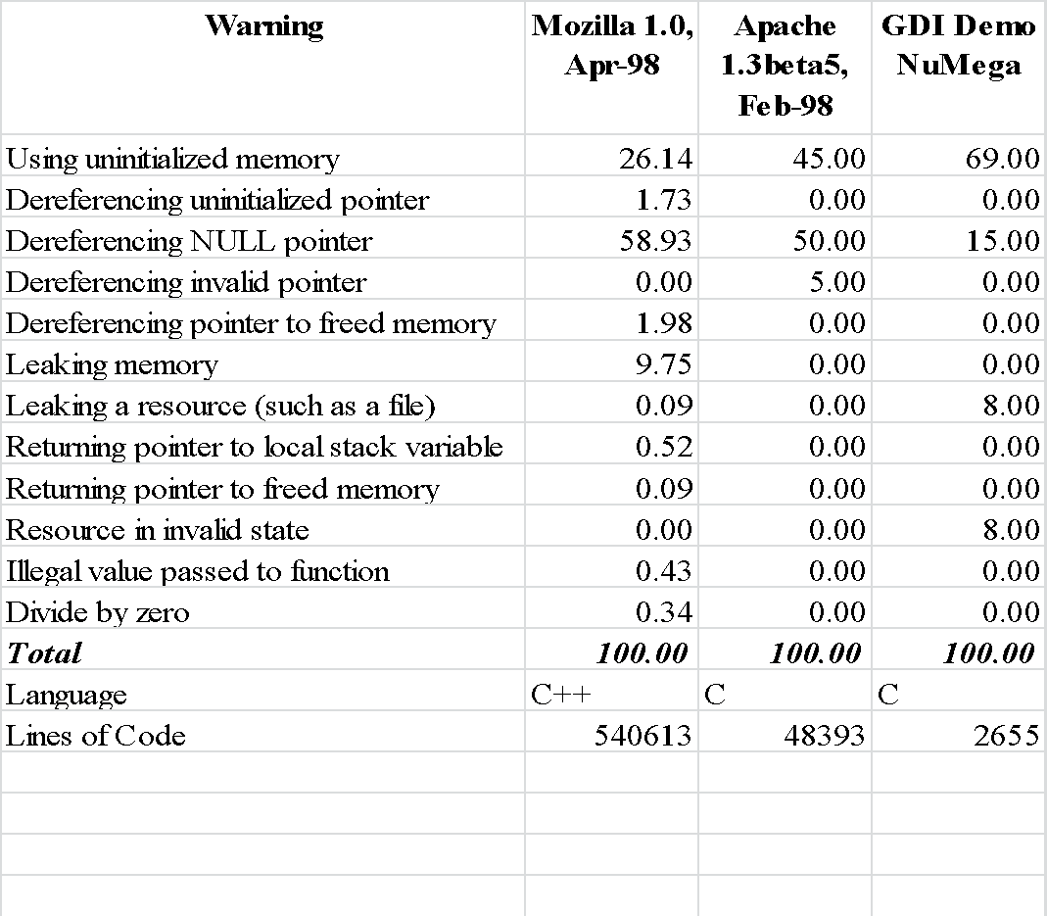
Pointer Hazards: PREfix Simulation Results
Apr-16
‹#›
Notes:
‹#›

Slide 18
A POINTER-FREE WORLD
Reality or Utopia?
Apr-16
‹#›
Notes:
‹#›

Slide 19
How to deal with an Object?
The object itself –
by value
Performance Issue
Redundancy Issue
As the memory address of the object –
by pointer
Lifetime Management Issue
Code Prone to Memory Errors
With an alias to the object –
by reference
Good when null-ness is not needed
Const-ness is often useful
Apr-16
‹#›
Notes:
‹#›

Slide 20
Pointers vis-à-vis Reference
Use ‘Reference’ to Objects when
Null reference is not needed
Reference once created does not need to change
Avoids
The security problems implicit with pointers
The (pain of) low level memory management (i.e. delete)
W/o pointer – Use
Garbage Collection
“Avoid working with pointers.
Consider using references instead.”
“Avoiding Common Memory Problems in C++” –
MSDN Article
Apr-16
‹#›
Notes:
‹#›

Slide 21
Pointers-free Languages
What is a pointer-free language?
There is no high-level construct to directly access the address of an Object
Internally, the language may use indirect addressing
Some pointer-free languages expose pointers through ‘illegal’ or ‘unsafe’ means
Apr-16
‹#›
Notes:
‹#›

Slide 22
Pointers-free Languages
Fortran
Use arrays to link
VB / VB.Net
Use Win32 API / Un-documented Functions to create pointers (link data structures)
Apr-16
‹#›
Notes:
‹#›

Slide 23
Pointers-free Languages
Java
Internally every Java object is accessed through a pointer
Explicit pointer in native method calls
“Most studies agree that pointers are one of the primary features that enable programmers to put bugs into their code. Given that structures are gone, and arrays and strings are objects, the need for pointers to these constructs goes away .”
– The Java Language Environment: A White Paper, Sun 1995. (http://java.sun.com)
Apr-16
‹#›
Notes:
‹#›

Slide 24
Pointers-free Languages
C#
Pointers omitted in core language
Can still be used in “Unsafe Code”
Modifier “unsafe”
Interfacing with the underlying operating system
Accessing a memory-mapped device
Implementing a time-critical algorithm
…
Apr-16
‹#›
Notes:
‹#›

Slide 25
Pointers-free Languages
D Programming Language
Dynamic arrays instead of pointers
Reference variables / objects instead of pointers
GC instead of explicit memory management
Vastly reduced need for pointers
“Programming languages should be designed not by piling feature on top of feature, but by removing the weaknesses and restrictions that make additional features appear necessary.”
– Revised Report on Scheme, 1991
Apr-16
‹#›
Notes:
‹#›

Slide 26
Pointers-free Languages
SmallTalk
Eiffel (www.eiffel.com)
Has no pointers only – object references.
Exact referencing mechanism does not matter.
In the expression x.f, the reference x might be:
A pointer to an object in the same address space, or
An Internet address of an object.
References enable the location and access method of an object to be transparent.
BETA
…
“A language that doesn't affect the way you think about programming, is not worth knowing.” – Alan Perlis
Apr-16
‹#›
Notes:
‹#›

Slide 27
SMART POINTERS IN C++
The Smartness …
Apr-16
‹#›
Notes:
‹#›

Slide 28
What is Smart Pointer?
A Smart pointer is a C++ object
Stores pointers to dynamically allocated (heap / free store) objects
Improves raw pointers by implementing
Construction & Destruction
Copying & Assignment
Dereferencing:
operator–>
unary operator*
Grossly mimics raw pointer syntax & semantics
Apr-16
‹#›
Notes:
‹#›

Slide 29
What is Smart Pointer?
Performs extremely useful support tasks
RAII – Resource Acquisition is Initialization Idiom
Selectively disallows “unwanted” operations
Address Arithmetic
Lifetime Management
Automatically deletes dynamically created objects at appropriate time
On face of exceptions – ensures proper destruction of dynamically created objects
Keeps track of dynamically allocated objects shared by multiple owners
Concurrency Control
Apr-16
‹#›
Notes:
‹#›

Slide 30
A Simple Smart Pointer
template <class T> class SmartPtr {
public:
// Constructible. No implicit conversion from Raw ptr
explicit SmartPtr(T* pointee): pointee_(pointee);
// Copy Constructible
SmartPtr(const SmartPtr& other);
// Assignable
SmartPtr& operator=(const SmartPtr& other);
// Destroys the pointee
~SmartPtr();
// Dereferencing
T& operator*() const { ... return *pointee_; }
// Indirection
T* operator->() const { ... return pointee_; }
private:
T* pointee_; // Holding the pointee
};
Apr-16
‹#›
Notes:
‹#›

Slide 31
A Smart Pointer mimics a Raw Pointer
class MyClass {
public:
void Function();
};
// Create a smart pointer as an object
SmartPtr<MyClass> sp(new MyClass);
// As if indirecting the raw pointer
sp->Function(); // (sp.operator->())->Function()
// As if dereferencing the raw pointer
(*sp).Function();
Apr-16
‹#›
Notes:
‹#›

Slide 32
Smart Pointer Member Functions
Potential Name Conflict with pointee type
Method at namespace
SmartPtr<Printer> spRes = ...;
spRes->Acquire(); // acquire the printer ... print a document ...
spRes->Release(); // release the printer
spRes.Release(); // release the pointer to the printer
// GetImpl returns the pointer object stored by SmartPtr
template <class T> T* GetImpl(SmartPtr<T>& sp);
// GetImplRef returns a reference to the pointer stored by SmartPtr
template <class T> T*& GetImplRef(SmartPtr<T>& sp);
// Reset resets the underlying pointer to another value,
// Releases the previous one
template <class T> void Reset(SmartPtr<T>& sp, T* source);
// Release releases ownership of the smart pointer
template <class T> void Release(SmartPtr<T>& sp, T*& destination);
Apr-16
‹#›
Notes:
‹#›

Slide 33
A Smart Pointer Use-Case
A Distributed System
Objects can be
Local: Access is simple & fast
Remote: Access is involved & costly
How can an application code handle local & remote objects uniformly, robustly and elegantly?
Apr-16
‹#›
Notes:
‹#›

Slide 34
A Smart Pointer Use-Case
template<class T> // Template for Smart
class DBPtr { // Pointers to objects
public: // in a distributed DB
DBPtr(T *realPtr = 0); // Create a Smart ptr to a
// DB object given a local
// raw pointer to it
DBPtr(DataBaseID id); // Create a smart ptr to a
// DB object given its
// unique DB identifier
... // other smart ptr functions
};
Apr-16
‹#›
Notes:
‹#›

Slide 35
A Smart Pointer Use-Case
class Tuple { // class for database tuples
public: ...
void displayEditDialog(); // present a graphical
// dialog box allowing a
// user to edit the tuple
bool isValid() const; // return whether *this
}; // passes validity check
template<class T> // template class for making
class LogEntry { // log entries whenever a T
public: // object is modified
// Begins log entry
LogEntry(const T& objectToBeModified);
// Ends log entry
~LogEntry();
};
Apr-16
‹#›
Notes:
‹#›

Slide 36
A Smart Pointer Use-Case
void editTuple(DBPtr<Tuple>& pt) {
LogEntry<Tuple> entry(*pt); // make log entry // for this edit
// Repeat display edit dialog for valid values
do {
pt->displayEditDialog();
} while (pt->isValid() == false);
}
Application is oblivious of Object location
No separate calls to start and stop logging
Robust against exception
Apr-16
‹#›
Notes:
‹#›

Slide 37
The Smartness …
It always points either to a valid allocated object or is NULL.
It deletes the object once there are no more references to it.
Fast. Preferably zero de-referencing and minimal manipulation overhead.
Raw pointers to be only explicitly converted into smart pointers. Easy search using grep is needed (it is unsafe).
It can be used with existing code.
Apr-16
‹#›
Notes:
‹#›

Slide 38
The Smartness …
Programs that don’t do low-level stuff can be written exclusively using this pointer. No Raw pointers needed.
Thread-safe.
Exception safe.
It shouldn’t have problems with circular references.
Apr-16
‹#›
Notes:
‹#›

Slide 39
SMART POINTERS IN C++
Storage Policy
Apr-16
‹#›
Notes:
‹#›

Slide 40
3–Way Storage Policy
The Storage Type (T*)
The type of pointee.
Specialized pointer types possible: FAR, NEAR.
By “default” – it is a raw pointer.
Other Smart Pointers possible – When layered
The Pointer Type (T*)
The type returned by operator–>
Can be different from the storage type if proxy objects are used.
The Reference Type (T&)
The type returned by operator*
Apr-16
‹#›
Notes:
‹#›

Slide 41
SMART POINTERS IN C++
Ownership Management Policy
Apr-16
‹#›
Notes:
‹#›

Slide 42
Ownership Management Policy
Smart pointers are about ownership of pointees
Exclusive Ownership
Every smart pointer has an exclusive ownership of the pointee
Three common flavors for this policy
Destructive Copy – std::auto_ptr
Deep Copy [Raw Pointers have Shallow Copy]
COW: Copy-on-Write
Shared Ownership
Ownership of the pointee is shared between Smart pointers
Track the Smart pointer references for lifetime
Reference Counting
Reference Linking
Apr-16
‹#›
Notes:
‹#›

Slide 43
Ownership Policy: Destructive Copy
Exclusive Ownership Policy
Transfer ownership on copy
Source Smart Pointer in a copy is set to NULL
Available in C++ Standard Library
std::auto_ptr
Implemented in
Copy Constructor
operator=
Apr-16
‹#›
Notes:
‹#›

Slide 44
Ownership Policy: Destructive Copy
template <class T> class SmartPtr {
public:
SmartPtr(SmartPtr& src) { // Src ptr is not const
pointee_ = src.pointee_; // Copy
src.pointee_ = 0; // Remove ownership for src ptr
}
SmartPtr& operator=(SmartPtr& src) { // Src ptr is not const
if (this != &src) { // Check & skip self-copy
delete pointee_; // Release destination object
pointee_ = src.pointee_; // Assignment
src.pointee_ = 0; // Remove ownership for src ptr
}
return *this; // Return the assigned Smart Pointer
} ...
};
Apr-16
‹#›
Notes:
‹#›

Slide 45
Ownership Policy: Destructive Copy – The Maelstrom Effect
Consider a call-by-value
Display acts like a maelstrom of smart pointers:
It sinks any smart pointer passed to it.
After Display(sp) is called, sp holds the null pointer.
Lesson – Pass Smart Pointers by Reference.
Smart pointers with destructive copy cannot usually be stored in containers and in general must be handled with care.
void Display(SmartPtr<Something> sp); ...
SmartPtr<Something> sp(new Something);
Display(sp); // sinks sp
STL Containers need FCO.
Apr-16
‹#›
Notes:
‹#›

Slide 46
Ownership Policy: Destructive Copy – Advantages
Incurs almost no overhead.
Good at enforcing ownership transfer semantics.
Use the “maelstrom effect” to ensure that the function takes over the passed-in pointer.
Good as return values from functions.
The pointee object gets destroyed if the caller doesn't use the return value.
Excellent as stack variables in functions that have multiple return paths.
Available in the standard – std::auto_ptr.
Many programmers will get used to this behavior sooner or later.
Apr-16
‹#›
Notes:
‹#›

Slide 47
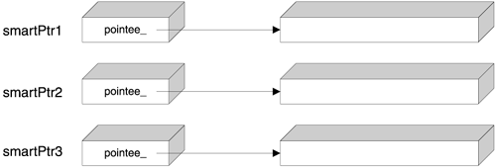
Ownership Policy: Deep Copy
Exclusive Ownership Policy
Only one Smart Pointer for every pointee object
Copy the pointee Object when copying the Smart Pointer
Does it have any worth over call-by-value?
Implemented in
Copy Constructor
operator=
Apr-16
‹#›
Notes:
‹#›

Slide 48
Ownership Policy: Deep Copy – Object Slicing
Naïve implementation
Does not work for polymorphic objects
Object Slicing: only ‘base’ part of a derived class object is copied
template <class T>
class SmartPtr {
public:
SmartPtr(const SmartPtr& other): pointee_(new T(*other.pointee_))
{ ... }
...
};
Apr-16
‹#›
Notes:
‹#›

Slide 49
Ownership Policy: Deep Copy – Transport Polymorphic Objects
Smart implementation
Safe mechanism to transport polymorphic objects
// Base class provides a prototype for Clone
class AbstractBase { ...
virtual Base* Clone() = 0;
};
// Derived class implements Clone
class Concrete : public AbstractBase { ... virtual Base* Clone() {
return new Concrete(*this);
}
};
Apr-16
‹#›
Notes:
‹#›

Slide 50
Ownership Policy: Copy-on-Write (COW)
Exclusive Ownership Policy
Allow multiple Smart pointers to point to the same pointee
Copy the pointee Object when it is written to (Lazy Evaluation)
Smart pointers are not the best place to implement COW
cannot differentiate between calls to const and non-const member functions of the pointee object.
COW is used in Meyers’ String Class.
Apr-16
‹#›
Notes:
‹#›

Slide 51
Ownership Policy: Reference Counting
Shared Ownership Policy
Allow multiple Smart pointers to point to the same pointee
A count of the number of Smart pointers (references) pointing to a pointee is maintained
Destroy the pointee Object when the count equals 0
Do not keep: raw pointers and smart pointers to the same object.
Apr-16
‹#›
Notes:
‹#›

Slide 52
Ownership Policy: Reference Counting
Variant Sub-Policies include
Non-Intrusive Counter
Multiple Raw Pointers per pointee
Single Raw Pointer per pointee
Intrusive Counter
Implemented in
Constructor
Copy Constructor
Destructor
operator=
Apr-16
‹#›
Notes:
‹#›

Slide 53
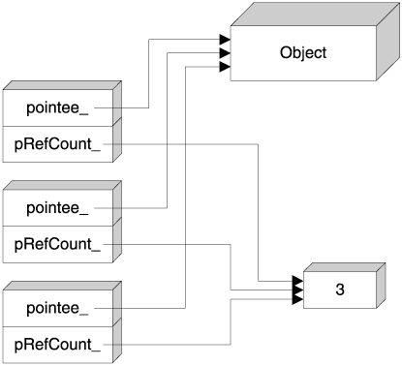
Ownership Policy: Reference Counting: Non-Intrusive Counter
Additional count pointer per Smart Pointer.
Count in Free Store
Allocation of Count may be slow & wasteful because it is too small
Apr-16
‹#›
Notes:
‹#›

Slide 54
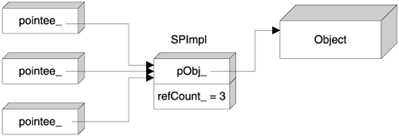
Ownership Policy: Reference Counting: Non-Intrusive Counter
Additional count pointer removed.
But additional access level means slower speed.
Apr-16
‹#›
Notes:
‹#›

Slide 55
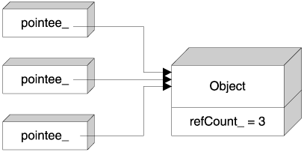
Ownership Policy: Reference Counting: Intrusive Counter
Most optimized RC Smart Pointer
Cannot work for an already existing design
Used in COM
Apr-16
‹#›
Notes:
‹#›

Slide 56
Ownership Policy: Reference Linking
Shared Ownership Policy
Allow multiple Smart pointers to point to the same pointee
All Smart pointers to a pointee are linked on a chain
The exact count is not maintained – only check if the chain is null
Destroy the pointee Object when the chain gets empty
Do not keep: raw pointers and smart pointers to the same object.
Apr-16
‹#›
Notes:
‹#›

Slide 57
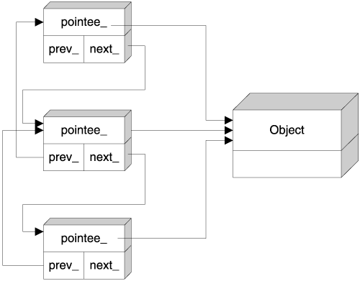
Ownership Policy: Reference Linking
Overhead of 2 additional pointers
Doubly-linked list for constant time:
Append,
Remove & Empty detection.
Apr-16
‹#›
Notes:
‹#›

Slide 58
Ownership Policy: Reference Management – Disadvantage
Circular / Cyclic Reference
Object A holds a smart pointer to an object B. Object B holds a smart pointer to A. Forms a cyclic reference.
Typical for a Tree: Child & Parent pointers
Cyclic references go undetected
Both the two objects remain allocated forever
Resource Leak occurs.
The cycles can span multiple objects.
Apr-16
‹#›
Notes:
‹#›

Slide 59
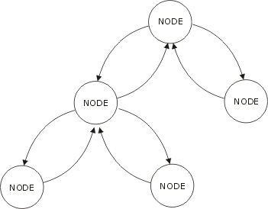
Ownership Policy: Cyclic Reference – Hack
The Hack
Use Smart pointer from Parent to Child.
“Data Structure” Pointers
Use Raw pointer from Child to Parent.
“Algorithm” Pointers
Smart Pointers “own”; Raw Pointers “disowns”?
Apr-16
‹#›
Notes:
‹#›

Slide 60
Ownership Policy: Cyclic Reference – Solution
Maintain two flavors of RC Smart Pointers
“Strong” pointers that really link up the data structure (Child / Sibling Links). They behave like regular RC.
“Weak” pointer for cross / back references in the data structure (Parent / Reverse Sibling Links)
Keep two reference counts:
One for total number of pointers, and
One for strong pointers.
While dereferencing a weak pointer, check the strong reference count.
If it is zero, return NULL. As if, the object is gone.
Apr-16
‹#›
Notes:
‹#›

Slide 61
SMART POINTERS IN C++
Implicit Conversion
Apr-16
‹#›
Notes:
‹#›

Slide 62
Implicit Conversion
Consider
User-Defined Conversion (cast)
User-unattended access to the raw pointer can defeat the purpose of the smart pointer
// For maximum compatibility this should work
void Fun(Something* p); ...
SmartPtr<Something> sp(new Something);
Fun(sp); // OK or error?
template <class T> class SmartPtr {
public:
operator T*() // user-defined conversion to T*
{ return pointee_; } ...
};
Apr-16
‹#›
Notes:
‹#›

Slide 63
Implicit Conversion: The Pitfall
This compiles okay!!!
Ambiguity Injection solves …
Prefer Explicit Conversion over Implicit
Use GetImpl() & GetImplRef()
// A gross semantic error that goes undetected at compile time
SmartPtr<Something> sp; ...
delete sp; // Compiler passes this by casting to raw pointer
template <class T> class SmartPtr {
public:
operator T*() // User-defined conversion to T*
{ return pointee_; }
operator void*() // Added conversion to void*
{ return pointee_; } ...
};
“When in doubt, use brute force.” – Ken Thompson
Apr-16
‹#›
Notes:
‹#›

Slide 64
SMART POINTERS IN C++
Null Tests
Apr-16
‹#›
Notes:
‹#›

Slide 65
Null Tests
Expect the following to work?
Implicit conversion to:
T*
void *
Implicit conversion 🡺 Risky delete 🡺 Ambiguity Injection 🡺 Ambiguity causes compilation failures
SmartPtr<Something> sp1, sp2;
Something* p; ...
if (sp1) // Test 1: direct test for non-null pointer ...
if (!sp1) // Test 2: direct test for null pointer ...
if (sp1 == 0) // Test 3: explicit test for null pointer ...
Apr-16
‹#›
Notes:
‹#›

Slide 66
Null Tests
Overload operator!
template <class T> class SmartPtr {
public:
// Returns true iff pointee is NULL
bool operator!()
{ return pointee_ == 0; }
};
if (sp1) // Rewrite as if (!!sp1)
if (!sp1) // Works fine
if (sp1 == 0) // Does not work
Apr-16
‹#›
Notes:
‹#›

Slide 67
SMART POINTERS IN C++
Checking Policy
Apr-16
‹#›
Notes:
‹#›

Slide 68
Checking Policy
Applications need various degrees of safety:
Computation-intensive – optimize for speed.
I/O intensive –allows better runtime checking.
Two common models:
Low safety / High speed (critical areas).
High safety / Lower speed.
Checking policy with smart pointers:
Checking Functions
Initialization Checking &
Checking before Dereferencing
Error Reporting
Apr-16
‹#›
Notes:
‹#›

Slide 69
Checking Policy: Initialization Checking
Prohibit a Smart Pointer from being NULL
A Smart Pointer is always valid
Loses the ‘not-a-valid-pointer’ idiom
How would default constructor initialize raw pointer?
template <class T> class SmartPtr {
public:
// Prohibit NULL for initialization
SmartPtr(T* p): pointee_(p) {
if (!p) throw NullPointerException();
} ...
};
Apr-16
‹#›
Notes:
‹#›

Slide 70
Checking Policy: Checking before Dereferencing
Dereferencing a null pointer is undefined!
Implemented in
Operator->
Operator*
if (p) { /* Dereference & use p */ }
else { /* Handle null pointer condition */ }
template <class T> class SmartPtr {
public:
T& operator*() const { // Dereferencing
if (!pointee_) throw NullPointerException();
else return *pointee_; }
T* operator->() const { // Indirection
if (!pointee_) throw NullPointerException();
else return pointee_; }
...
};
Apr-16
‹#›
Notes:
‹#›

Slide 71
Checking Policy: Error Reporting
Throw an exception to report an error
Use ASSERT in debug build
Checking (debug) + Speed (release)
Lazy Initialization – construct when needed
Operator->
Operator*
template <class T> class SmartPtr {
public:
T& operator*() { // Dereferencing. No Constant
if (!pointee_) pointee_ = new T;
return *pointee_; }
T* operator->() { // Indirection. No Constant
if (!pointee_) pointee_ = new T;
return pointee_; }
...
};
Apr-16
‹#›
Notes:
‹#›

Slide 72
SMART POINTERS IN C++
Other Design Issues
Apr-16
‹#›
Notes:
‹#›

Slide 73
What is a Smart Pointer?
Smart Pointer Operations
Construction, Copy Construction operator new
Destruction operator delete
De-referencing operator*
Indirection operator->
Assignment operator=
Null Test operator! (operator == 0)
Comparison operator==, operator!=, …
Cast operator(int), operator(T*)
Address Of operator&
Address Arithmetic operator+, operator-, operator++, operator--, operator+=, operator-=
Array operator new, operator delete, operator[]
Apr-16
‹#›
Notes:
‹#›

Slide 74
Other Design Issues
Comparison of two Smart Pointers
Equality, Inequality, Ordering
Checking and Error Reporting
Initialization checking
Checking before dereference
const-ness
Smart Pointers to const and
const Smart Pointers
Arrays
Multi-Threading / Locks
Proxy Objects
Apr-16
‹#›
Notes:
‹#›

Slide 75
SMART POINTERS IN C++
Performance Issues
Apr-16
‹#›
Notes:
‹#›

Slide 76
Space Overhead in Smart Pointers
Ownership | Overhead
Destructive Copy | Nil
Deep Copy | (n-1)*sizeof(<Object>)
COW | <= (n-1)*sizeof(<Object>)
RC: Non-Intrusive (n) | 4_{pointer}*n+4_{counter}
RC: Non-Intrusive (1) | 4_{pointer}+4_{counter}
RC: Intrusive | 4_{counter}
Reference Linking | 4_{pointer_next}*n+4_{pointer_prev}*n
Apr-16
‹#›
Notes:
‹#›

Slide 77
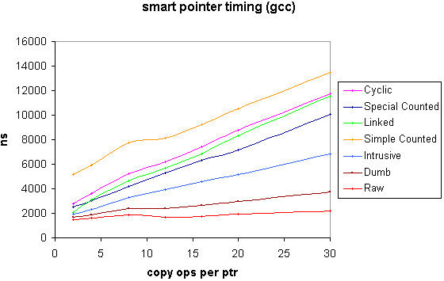
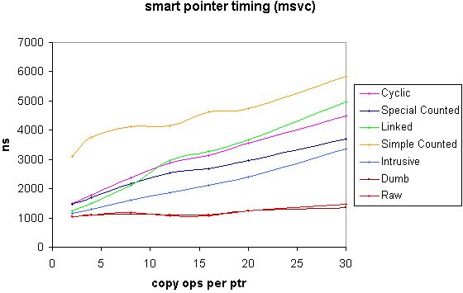
Smart Pointer Timing (GCC, MSVC)
Time in ns to acquire a pointer (default construction), perform n amortized copy operations on it & finally release it.
The allocation time for the contained pointer is not included, but the time for it's deallocation is.
A dumb pointer is a smart pointer that simply acquires and releases its contained pointer with no extra overhead. A raw pointer is a C pointer.
Apr-16
‹#›
Notes:
‹#›

Slide 78
References: Books
Effective C++ by Scott Meyers
More Effective C++: 35 New Ways to Improve Your Programs and Designs – Scott Meyers, Pearson Education & AWP 1999
Modern C++ Design: Generic Programming & Design Pattern Applied – Andrei Alexandrescu, Pearson Education 2001
C++ Templates: The Complete Guide – David Vandevoorde & Nicolai M. Josuttis, Pearson Education & AWP 2003
Exceptional C++ by Herb Sutter
More Exceptional C++ by Herb Sutter
The C++ Programming Language by Bjarne Stroustrup
Apr-16
‹#›
Notes:
‹#›

Slide 79
References: Papers
A static analyzer for finding dynamic programming errors - William R. Bush, Jonathan D. Pincus and David J. Sielaff, Software Practice Experience 2000; 30:775–802
Used for PREfix simulation results on Pointer Hazards
Apr-16
‹#›
Notes:
‹#›

Slide 80
References: Online Help
MSVC 6.0
MSVC 7.1
GCC
Apr-16
‹#›
Notes:
‹#›

Slide 81
References: Codes
<memory> header of Your Compiler
Apr-16
‹#›
Notes:
‹#›

Slide 82
References: Code URLs
CodeProject – http://www.codeproject.com
Smart Pointers
A Simple Smart Pointer
A Smart Pointer Capable of Object Level Thread
Smart Pointers to boost your code
The Fastest Smart Pointer in the West
The Safest Smart Pointer of the East
A generic C++ template class to implement a Smart Pointer
A COM Smart Pointer
Pointers (General)
How to do pointers in VB?
Pointers in Visual Basic using Undocumented Functions
Garbage Collectors
A garbage collection framework for C++
A garbage collection framework for C++ - Part II
Synchronization and Reference Counting Garbage Collection
Boost Library – http://www.boost.org
shared_ptr and its variants
Smart Pointer Timing
Apr-16
‹#›
Notes:
‹#›

Slide 83
References: Knowledge URLs
“Informal Language Comparison Chart(s)” – www.smallscript.org/Language%20Comparison%20Chart.asp
“Pointer Basics” – http://cslibrary.stanford.edu/106/
“Pointers, References & Values” – www.goingware.com
“Using auto_ptr Effectively” – www.cuj.com“Using auto_ptr Effectively” – www.cuj.com, October 1999 and www.gotw.ca/publications/using_auto_ptr_effectively.htm
“Smart pointer templates in C++” by David Harvey – www.davethehat.com/articles/smartp.htm
“C++ Without Memory Errors” by Dejan Jelović – www.jelovic.com/articles/cpp_without_memory_errors_slides.htm
“Smart Pointer Thread Safety” by Dejan Jelović – www.jelovic.com/articles/smart_pointer_thread_safety.htm
“The New C++: Smart(er) Pointers” by Herb Sutter – www.cuj.com, August 2000.
“Programming Language Comparion” by Jason Voegele – www.jvoegele.com/software/langcomp.html
“The case against C” by P. J. Moylan – www.modulaware.com/mdlt35.htm
“Smart Pointers - What, Why, Which?” by Yonat Sharon – http://ootips.org/yonat/4dev/smart-pointers.html
RAII Idiom and Managed C++ http://www.codeproject.com/managedcpp/managedraii.asp
GNU GCC 3.4
http://gcc.gnu.org/onlinedocs/libstdc++/latest-doxygen/memory-source.html
http://www.cs.huji.ac.il/~etsman/Docs/gcc-3.4-base/libstdc++/html_user/debug_8h-source.html
MSDN Library
http://msdn.microsoft.com
Apr-16
‹#›
Notes:
‹#›

Slide 84
Credits / Acknowledgements
Reena
helped in desk editing this presentation.
Scott Meyers
helped by providing pointers to various smart pointer resources.
Shyamal
for being a patient audience to my early stages of development of understanding
Apr-16
‹#›
Notes:
‹#›

Slide 85
Thank You
Don’t Beware of Pointers –
Just Be Aware of Smart Pointers
Apr-16
‹#›
Notes:
‹#›

